Slide 1
2020 Water Supply (CIWS) Data Visualization Challenge
Andres Duque
Dec. 10th 2020

Slide 2
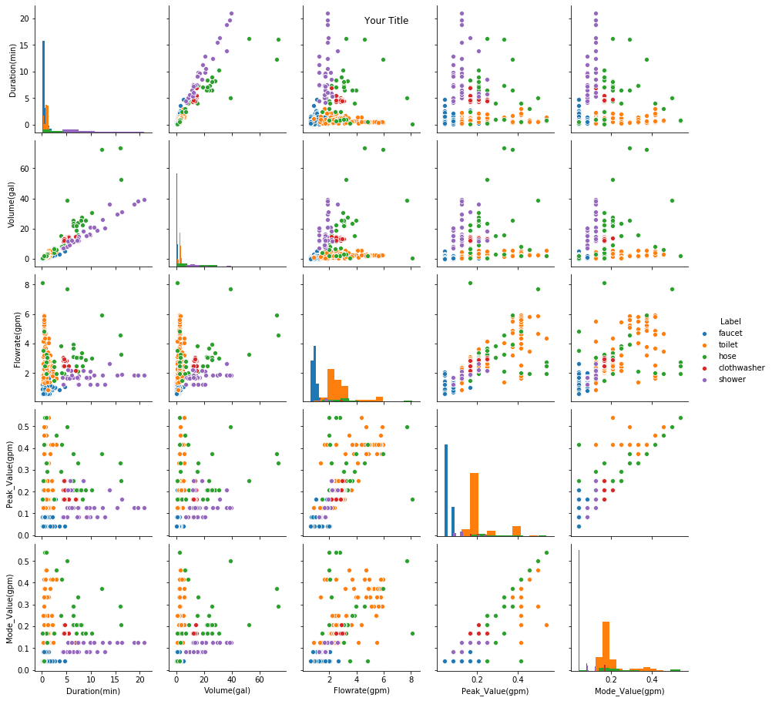
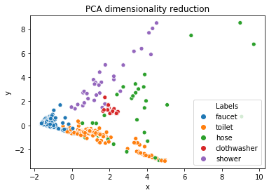
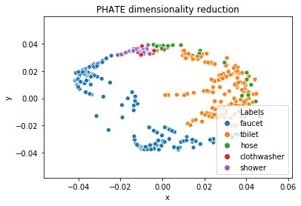
Exploratory analysis
The classes seem to be well separated by the features selected.
The most erratic behavior is in the hose.
Clothwasher uses are the most similar.
PCA shows two clusters for toilet

Slide 3
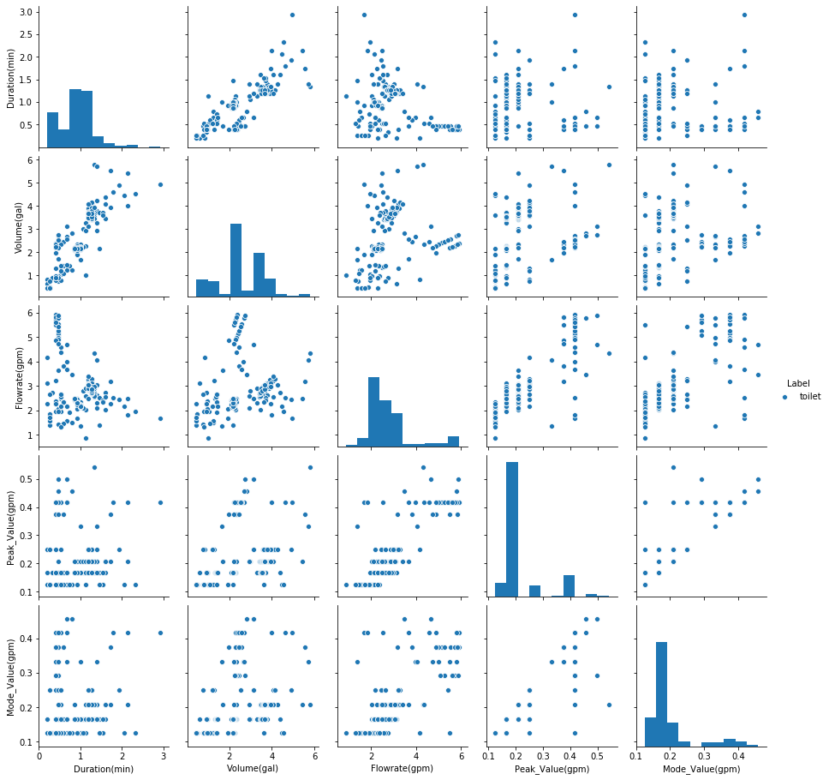
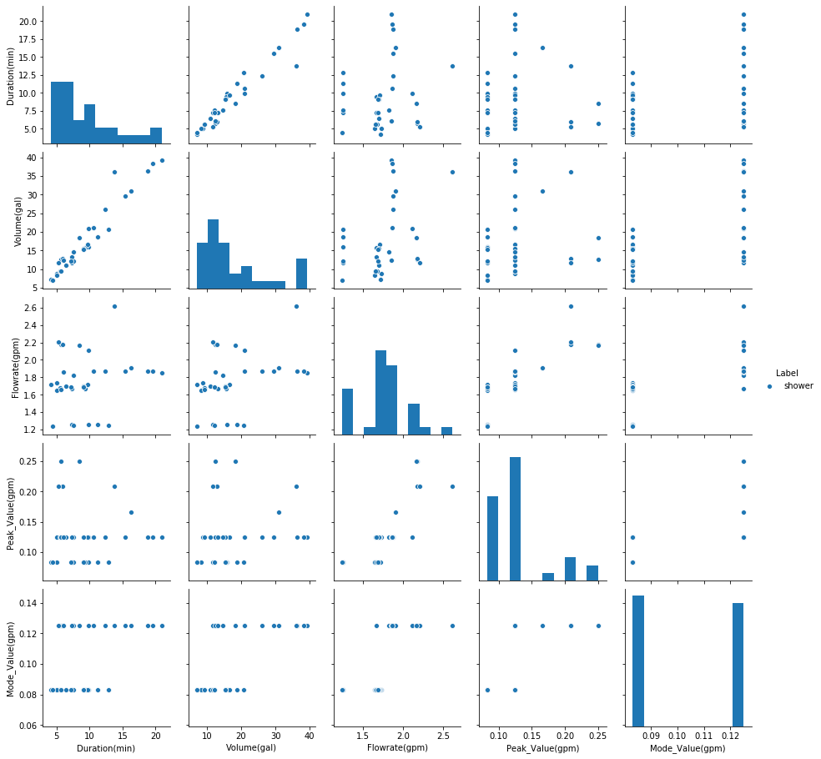
Exploratory analysis shower and toilet.

Slide 4
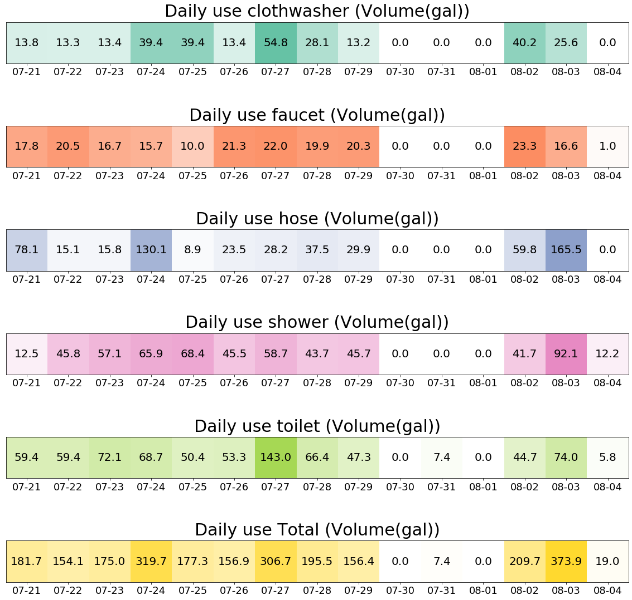
How water is consumed by days
Possible ways to identify cyclical patterns and leaks.
Detect anomaly behavior in certain days.

Slide 5
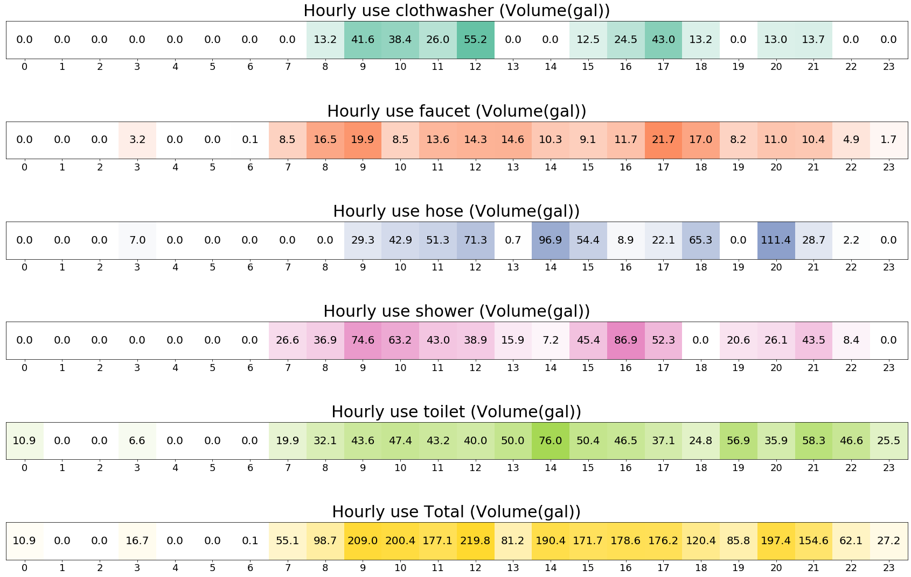
How water is consumed by hours
Identify if someone in the house with certain hourly patterns of shower is consuming more than the rest.

Slide 6
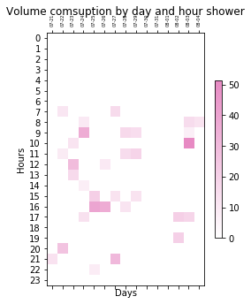
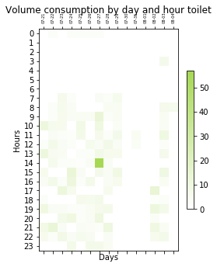
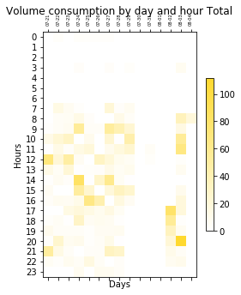
How water is consumed by days and hours
Combination of the previous plots.
More detailed observation of patterns and anomalies.

Slide 7
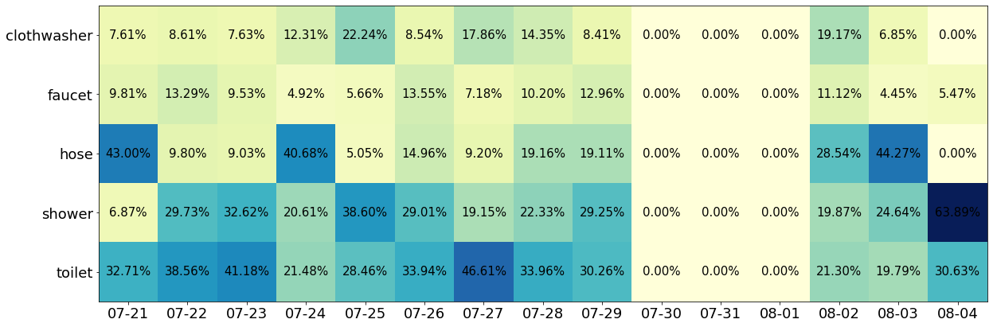
Daily percentages for each of the uses

Slide 8
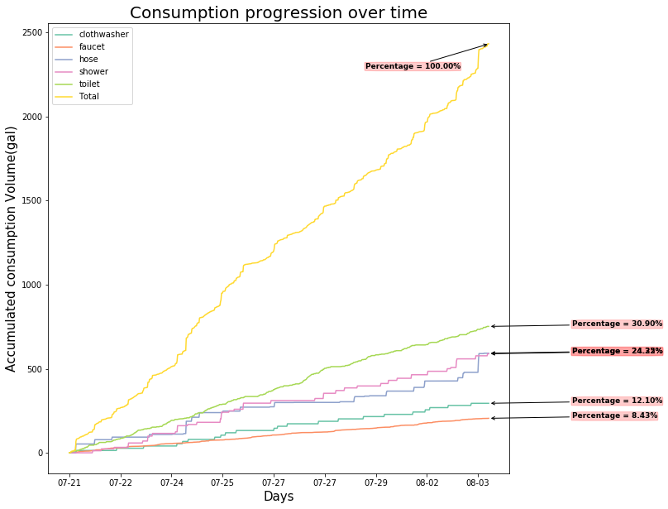
Visualize which appliances are consuming the most at the end of the month.

Slide 9
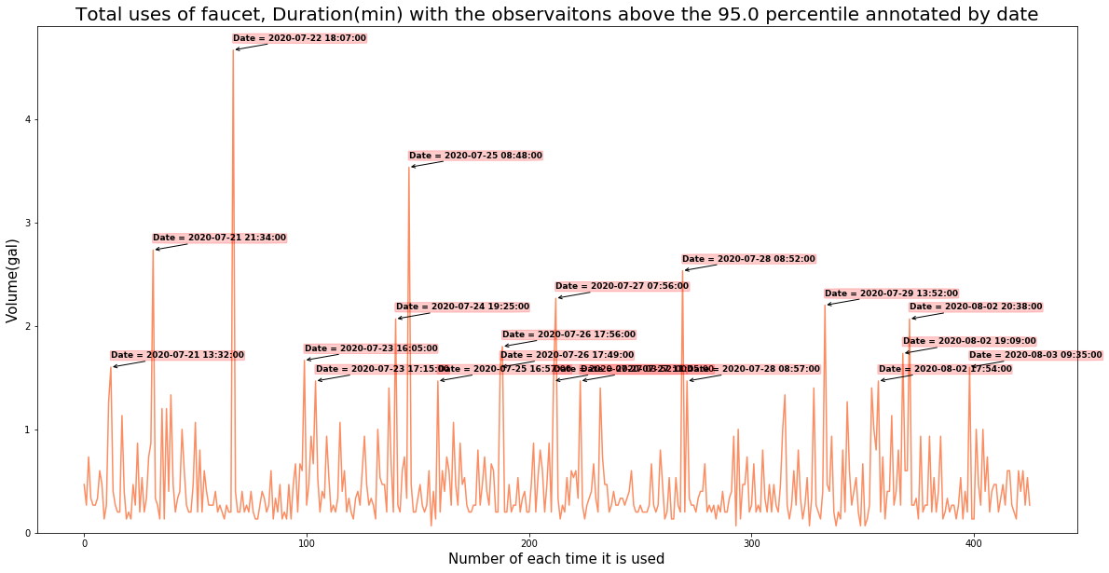
Individual observations by feature and type of use with anomalies labeled by date

Slide 10
